Slide 1

Business Analysis MARKETING PLAN
Pivot & Co Data Science Team

Slide 2

Agenda of Business Analysis
Understand, Assess the Business Performance and Budget Allocation for next years through sales performance, past data exploration and business operation.
Providing corrective measures to overcome challenges faced by the business

Slide 3

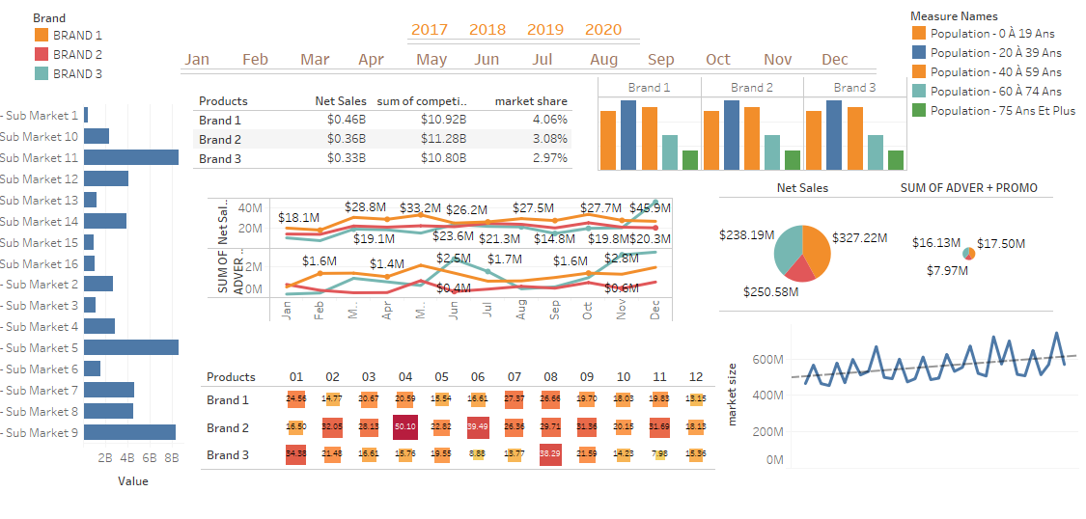
COMPANY OUTLOOK

Slide 4
Company Market Share:
Brand 1
Brand 2
Brand 3
4.06%
3.08%
2.97%
Products | Net Sales | Sum of Competitor | Market Share
Brand 1 | € 0.46 B | € 10.92 B | 4.06%
Brand 2 | € 0.36 B | € 11.28 B | 3.08%
Brand 3 | € 0.33 B | € 10.80 B | 2.97%

Slide 5
Company Market Share (Contd.)
If we carefully review the total market share, we can see that the market is dominated by our competitors.
For all of the 3 Brands, our competitors are eating us away.
While we have only the 4.06%, 3.08 and 2.97% of market share for Brand1, Brand2 and Brand3 respectively, it shows that there is a massive gap and our competitors are far ahead of us in terms of owning the market share.
For example for Brand1, our net sales is € 0.46 B as compared to our competitors who have the net sales of worth € 10.92 B.
In order to remove this huge gap in the market shares, we need to come up with creative strategies to even compete and stay in the market and to catch up with the market.
For example, we can create advertising campaigns that can create a sense of brand loyalty amongst our existing and new customers.

Slide 6
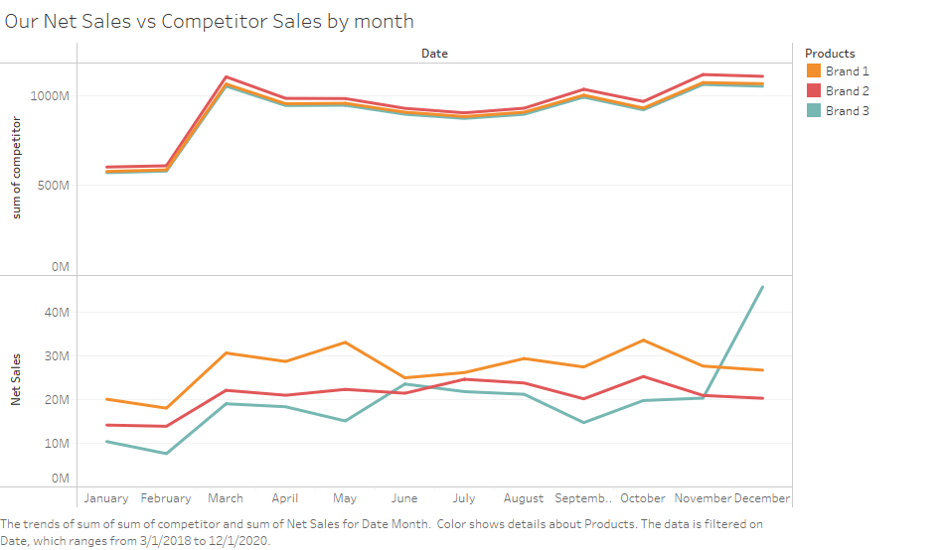
Net Sales VS Competitor Sales
This graph lets us see the Net Sales comparison with our competitors.
We can clearly see that we are far behind our competitors in terms of the market capture and Net Sales.
Also, we can see the fluctuation in our graph indicating the inconsistency of our Brands Sales in different times as compared to our competitors who have a certain level of consistency and uniformity in regards to their product sales.

Slide 7
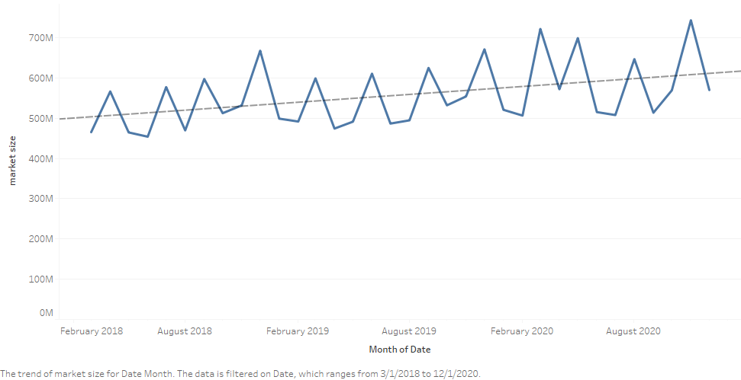
Evolution of Market Size
This graph shows the evolution of the Market size monthly. The market is huge and is worth more than 600M but we are hardly capturing 3-4% of that. It goes to show that we have a lot catching up to do if we want to capture a reasonable market size.

Slide 8

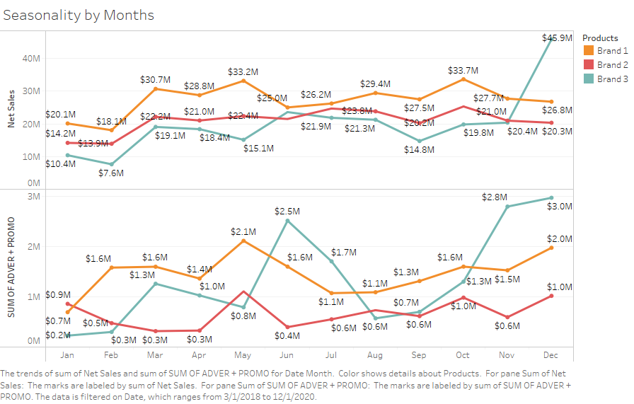

Slide 9
Seasonality by Months (Contd.)
We compare the Net Sales with the spending monthly and try to see the Seasonality of our Brands
The graph (previous slide) shows the seasonality of all of our brands monthly comparing the Unit Sales with Advertising and Promotion spend.
If we dig deep into this graph, we can see that we are spending the least on Brand 2 and more on Brand 1 and 3.
Lets just take one scenario for instance, if we take the month of Jun, we can see that we are spending the most on Brand 3 but the net sales is not very high. So instead of spending our budget here, we can utilise it somewhere else.
Lets take another example for the month of Nov for Brand3, we can see that again we are spending a lot but with no exception net sales so again we can utilise this spend somewhere else.
Furthermore from this graph, we can see that Dec is the peak month for Brand3, Oct is the peak month for Brand1 and Brand2. So this gives us an idea of where to prioritize our budget spending.

Slide 10
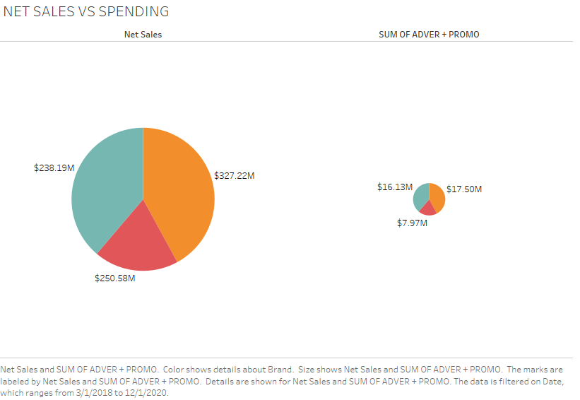

SALES vs SPENDING
If we observe these pie charts, we can see that we are spending the least on Brand 2 but it still gets a reasonable ROI more than Brand 3 on which we are spending more than double of Brand 2 but with not such exception ROI.
It means that if we make more spending of our budget on Brand 2 instead of Brand 3, we can have even more ROI from Brand 2.
To conclude, we can say that Brand 2 needs more of the budget allocation because of its high ROI.

Slide 11
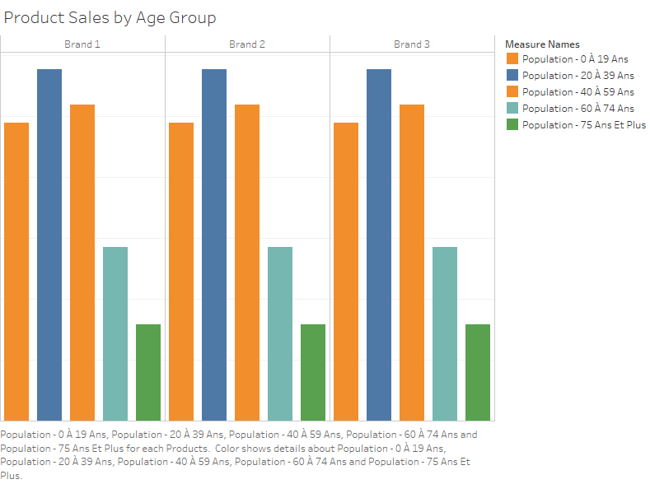
Product Sale by Age Group
This graph indicates the Market Segments which we need to focus more on for our Marketing and Promotion spend.
As we can see, our net sales are much higher for the age groups of customers < 60 and not so much for the age group of >=60.
So we can focus on the younger age population group as it seems that our products are more popular in that group as compared to the older age population group.

Slide 12

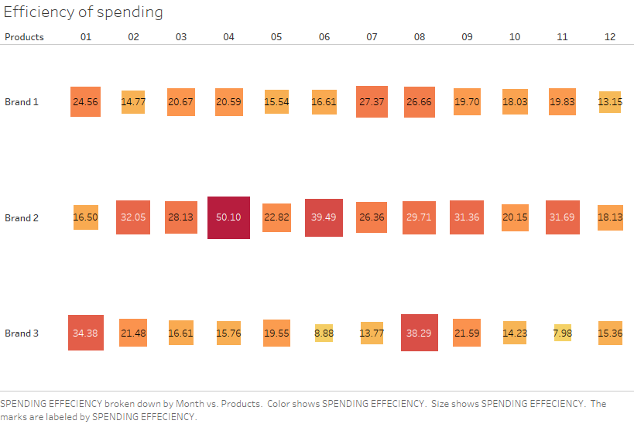
Efficiency of Spending
The peak level of performance that uses the least unit of input to achieve the highest amount of output.
This illustration shows the value that we get for spending the smallest unit (1 €) on our Brands.
As we can see, for Brand 2 for the month of April, we get the value of 50.10 € on spending 1 €. Similarly we have high efficiency for all brands in different months which gives us an idea of where and when to allocate our budgets.

Slide 13

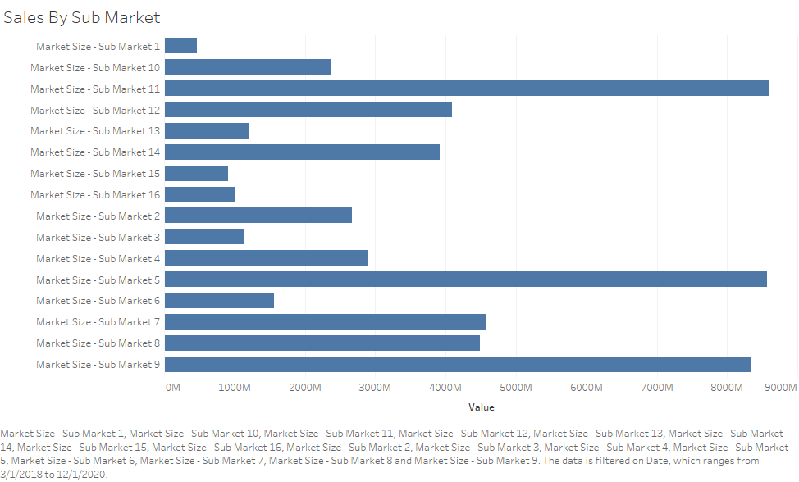
Sales by Sub Market
This graph illustrates our sales by the market segmentation since we have defined our sub markets.
If we review, for sub market groups 5,11 and 9 - we have excellent sales.
But if we talk about the rest of the sub groups especially Sub Markets 15,16 and 13 etc, we can clearly see that we are not capturing the market well.
So we need to come up with the strategies to focus more on such groups, maximize the sales and capture more of these markets.

Slide 14
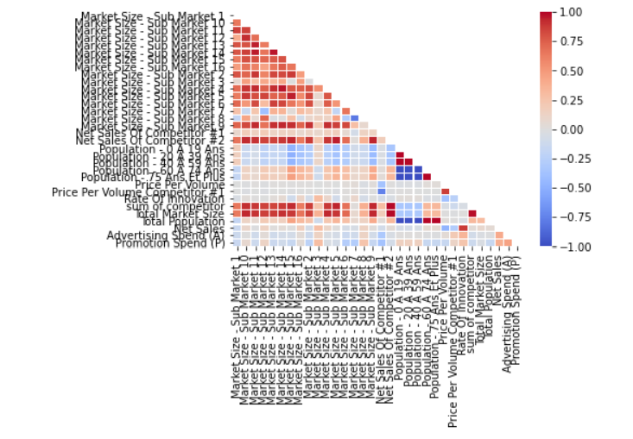
Rate of Innovation
Rate of Innovation
If we see the heatmap above, it indicates that the our target Net Sales is very much correlated with the Rate of Innovation. The higher the innovation rate, the higher the Net Sales. So we can say that we need to focus and prioritize on Rate of Innovation too for our efficient Sales results and to capture the market too.

Slide 15


MAJOR CHALLENGES
Market Share
The main challenge is that we do not have the enough market share. We own only about 3-4% of the share while the rest is owned by the competitors. We need to maximize our market share.
Budget Allocation Priority
As we saw before, we are spending a sizeable amount on Brand 3 but with no extra ordinary results while Brand 2 performs much better with limited budget allocation. So we need to prioritize our budget allocation based on ROI.
Penetration into the Market
As we saw before, we do not have a deeper market penetration. We have to get through to our customers using creative marketing strategies (for example targeting our market segments smartly), efficient budget allocation and to increase our efficiency of spending which is inconsistent.

Slide 16

THANK YOU!

